Slide 1
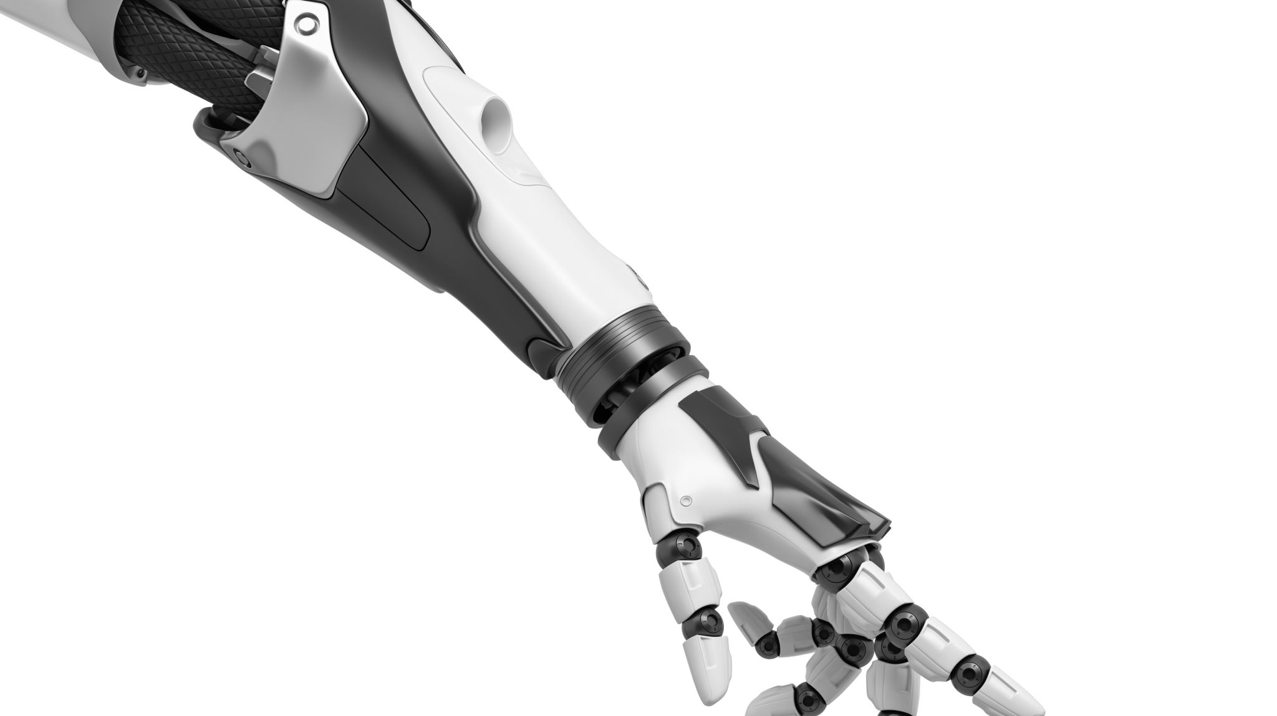
Autonomous Robotic Stone StackinG with Online next best object target pose planning
Paper presented in 2017 ICRA - Singapore
Authors:
Fadri Furrer – Object Detection
Martin Wermelinger – Manipulation Tasks
Hironari Yoshida – Pose Searching Algorithm
ETH Zurich, Switzerland

Slide 2

Abstract Story:
A pipeline to detect randomly placed objects & performing stacking pose searching method by making use of a physics engine

Slide 3
Introduction
Last Decade…….
Digital Fabrication
Irregular material with adhesives

Slide 4

Work-flow

Slide 5

Related Work:
Localization of robot in uncontrolled environment full of uncertainities
Limit Analysis
Material Behavior

Slide 6
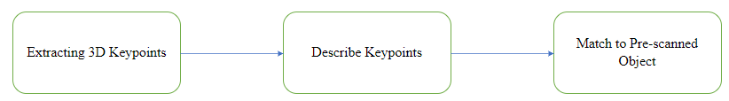
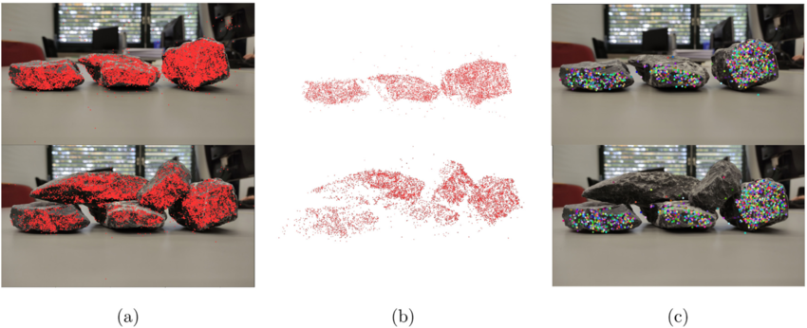
Object Detection Pipeline:
Key-point extraction and description.
To extract the keypoints from the scene point cloud using the RGB-D sensor, they have used two methods:
1) Voxel-based Subsampling.
2) Point Cloud Library (PCL)
For the descriptor they have mainly used, the ISS descriptor along with it they also tested two additional descriptors namely:
1)Fast Point Feature Histogram (FPFH) descriptor
2)Rotational Projection Statistics (RoPS) descriptor.

Slide 7
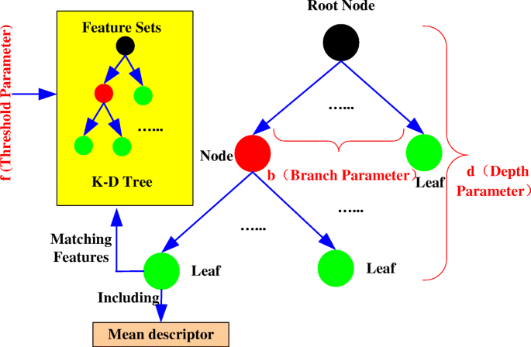
Descriptor Matching and Clustering
Keypoints from the scene are compared with keypoints from pre-scanned object models to find potential matches.
They set up a kd-tree in the descriptor space and performed a nearest neighbor search to find the pair of most similar keypoints.
The geometrical consistency of the matched keypoints was verified to ensure that the matches correspond to physically plausible correspondences.
Multiple potential transforms were computed, each representing a potential alignment between the scene and the object model, and the best transforms were selected.

Slide 8
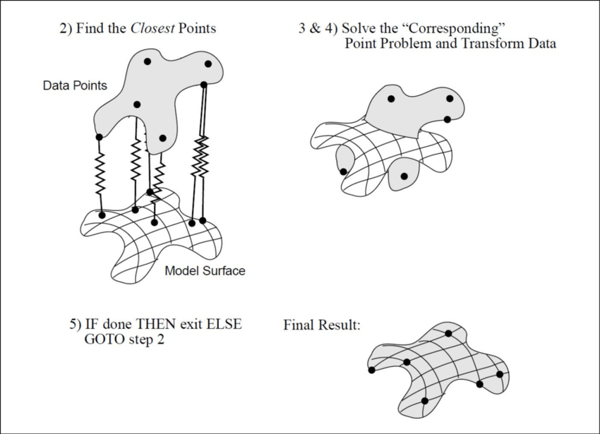
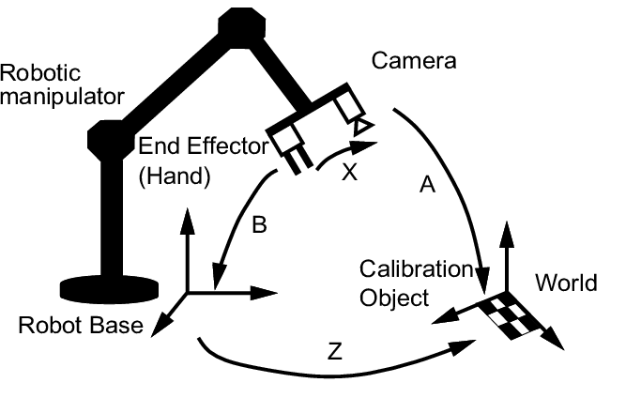
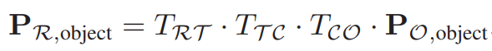
Transform Refinement and Verification
The selected transforms were further refined using the Iterative Closest Point (ICP) algorithm.
Iterative Closest Point (ICP): This algorithm iteratively refines the transformation between two-point clouds by minimizing the distance between corresponding points.
Finally, the model points with an inlier ratio greater than the threshold value of 20% were selected and is denoted by (Tco)
Object in Robot Arm Frame
The point cloud of the localized object (P_{O}) is transformed into the frame of the robot arm for manipulation. (P_{R})
This transformation involves applying the best transform obtained earlier (Tco), a pre-calibrated transform from the camera frame to the robot tooltip frame (T_{TC}), and the transform representing the current state of the robot arm frame and tool tip frame (T_{RT})

Slide 9
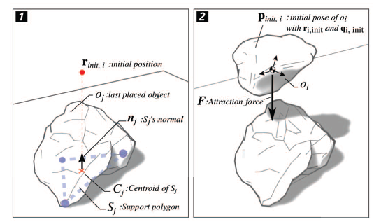
Pose Searching algorithm:
Deciding on the next possible Stable Pose Stack
Algorithm Purpose:
Construct a vertical tower by optimally placing irregular stones from a set.
Search Spaces:
Uses discrete space for stone selection and continuous space for placement optimization.
Stability Check:
Employs dynamic simulation to test each stone's stability.
Placement Scoring:
Assigns scores based on support, stability, and energy efficiency.
Adaptability:
Adjusts initial guesses to find the best placement solution.
Selection Method:
Initiates with random orientations to manage complexity.
Final Selection:
Chooses the best stone and position for stability and efficiency.

Slide 10
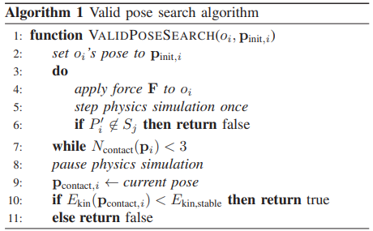
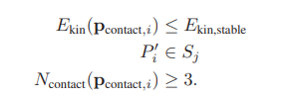
Valid Pose Search Algorithm:
Stability Verification: Check if the object's center of mass aligns within its support area for stability.
Support Polygon Role: Use the object's base or contact points to define its stability zone.
Initial Pose Setting: Begin with a predetermined pose and apply a force to test physical reactions.
Simulation for Stability: Conduct a simulation to ensure the center of mass remains within the stability zone.
Minimum Contact Points: Require at least three points of contact for a stable foundation.
Kinetic Energy Limitation: Assess kinetic energy to prevent destabilizing the structure.
Valid Pose Criteria: Validate poses that minimize energy, ensure center mass alignment, and maintain contact requirements.
Pose Selection Efficiency: Filter for poses that guarantee stability and structural integrity with minimal adjustment.

Slide 11
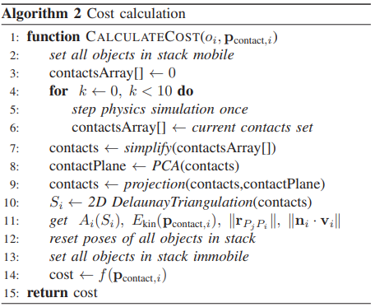
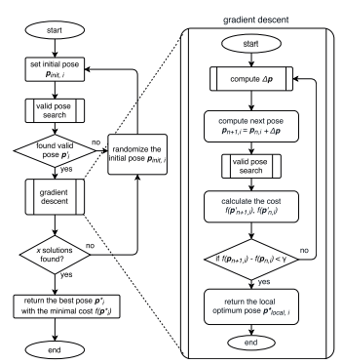
Cost Calculation
Purpose: Assign cost to stone poses for optimal stacking.
Support Maximization: Increase the base area (support polygon) for stability.
Minimization Goals: Reduce kinetic energy and shear force potential.
Process:
Simulate to collect contact points.
Perform PCA and 2D Delaunay triangulation for area calculation.
Cost Function: Combines support area, kinetic energy, and normal deviation metrics.
Optimization Technique: Uses gradient descent to refine stone poses.
Outcome: Identifies the pose with minimal cost for stable stacking.

Slide 12
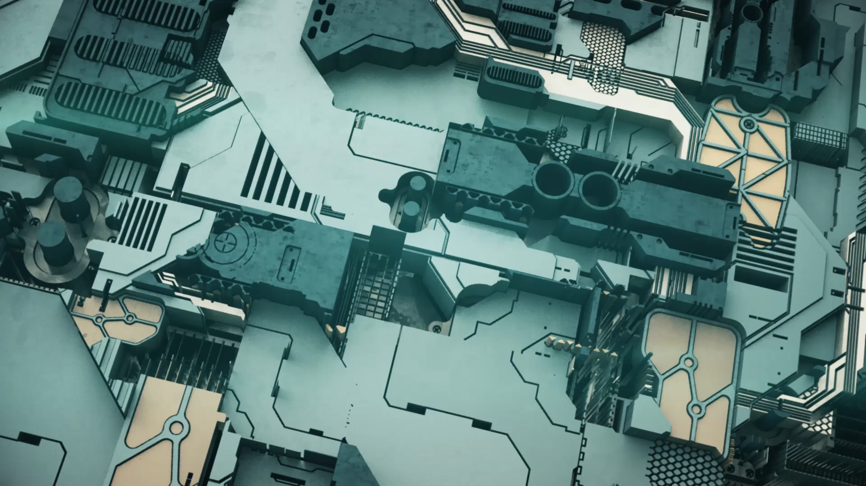
Experimental Setup:

Slide 13
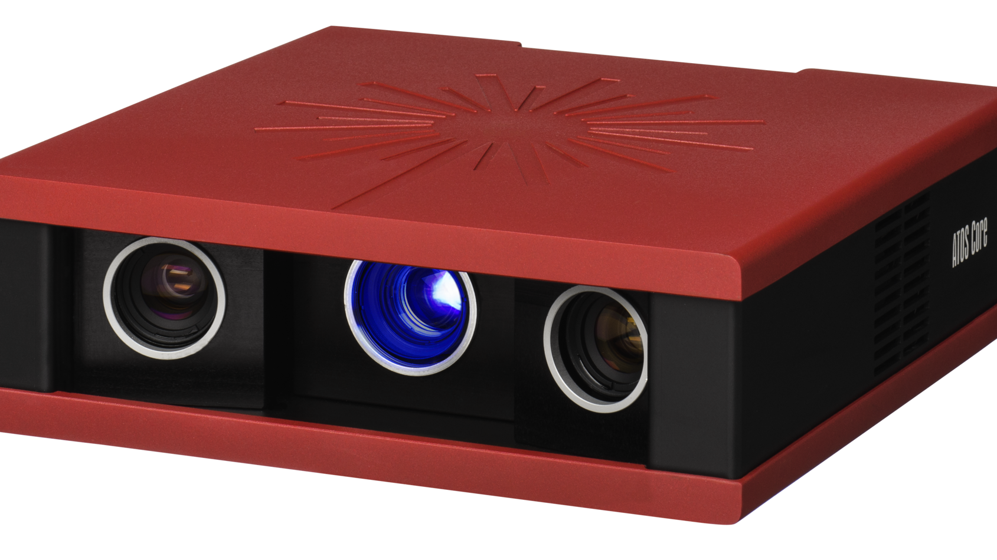
Atos Core high precision scanner
Point cloud and mesh model of of the object’s Geometric Shape

Slide 14
Lime Stones with irregular shape
~ 0.1
Lime-Stone: Low Friction coefficient
Irregular Shape: Additional challenges for vertical stacking

Slide 15
FT150 Force-Torque Sensor
Operating Station
UR10 with ROBOTIQ 3-Finger Gripper
Intel Real-Sense SR300 RGB-D camera

Slide 16
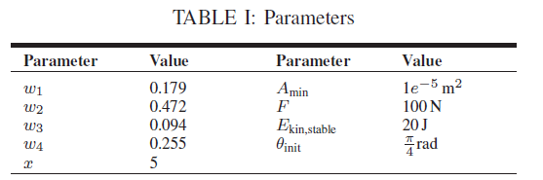
Motion Planning
Localized Stones
Pose Searching Algorithm
Random Selection of 4 stones
Next Stable Stack
Weights, Area, Force, Kinetic Energy

Slide 17
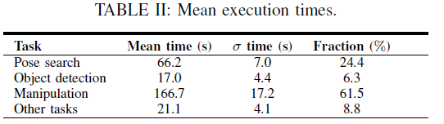
Performance:
Performance:
Eleven consecutive runs
Two runs - Successful 4 stone stacking
Six runs – Successful 3 stone stacking
Three runs – Successful 2 stone stacking
Eleven consecutive runs
Two runs - Successful 4 stone stacking
Six runs – Successful 3 stone stacking
Three runs – Successful 2 stone stacking

Slide 18
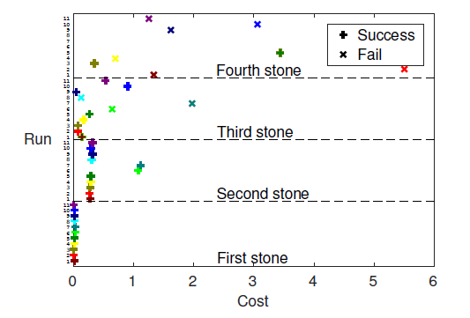

Slide 19
Conclusion and future work
Introduced an autonomous robotic system capable of constructing balancing vertical towers from irregularly shaped stones without extra materials.
Future improvements can be handling unseen objects, and creating more complex structures like arches or walls, requiring analysis of complex thrust line networks.

Slide 20

Thank you
Open to QUESTIONS!

